Slide 1
DME/Special Services

Slide 2
Overview of eQsuite®
Secure transmission protocols that are HIPPA security compliant
A reporting module that allows hospitals to obtain real-time status of all reviews.
Electronic submission and Provider Alerts
System access control for changing or adding authorized users.
24/7 accessibility to submit review requests
A helpline module for Providers to submit queries.

Slide 3
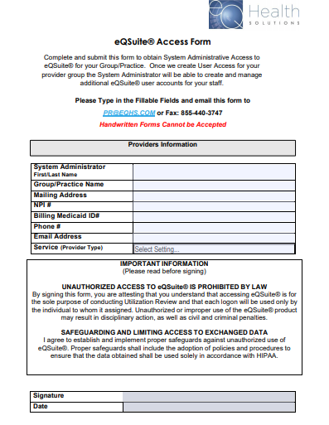
How to access eQsuite®
New Users:
You will need to complete and submit an access form.
(Once received and entered you will receive an email confirmation with your username and password)
System Administrator:
The person assigned will be responsible keeping all user accounts updated. (Email address/phone numbers etc.)
You will have the ability to create additional User Accounts.
Keeping all users informed of any updates or notifications sent from eQHealth.

Slide 4
Resources for DME
DME Fee Schedule
Durable Medical Equipment (DME) and Medical Supply Services
Pricing is based on AHCA maximum payment guidelines and is not negotiable. eQHealth does not have the authority to negotiate, alter, or apply any other pricing strategy. Pricing information is available prior to a medical necessity determination. This information does not guarantee approval of the request nor payment for services.
Please utilize the Florida DME Fee Schedule Pricing.
Authorization Requirements Policy
Florida Medicaid Authorization Requirements Policy
FL Medicaid DurableMedical Equipment & Supplies Coverage Handbook
FL Medicaid Durable Medical Equipment and Medical Supply Services Coverage & Limitations Handbook

Slide 5
Prior Authorization Numbers
Please reference the Florida Medicaid Fee Schedule for Authorization Requirements. The Fee Schedule can be found on AHCA’s website or on our website FL.ACENTRA.COM
On the Fee Schedule if the code has a “PA” this means the code requires prior authorization and once approved you will receive your authorization letter with a PA#.
If the code only states “Medical Necessity” the code requires prior authorization however it does not require a PA #. A PA# will NOT generate when you receive your authorization letter.
Note: To avoid a denial on your claims make sure to include your authorization letter with your claim submission.
By Report (BR) This column identifies a “Non-Classified” procedure code that requires a medical review to approve and price the procedure correctly.

Slide 6
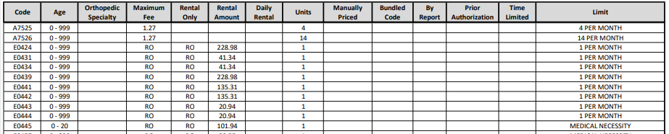
Prior Authorization Numbers
Example:
E0445 Oximeter Device For Measuring Blood Oxygen Levels, Non-Invasive
On the Fee Schedule it states “Medical Necessity” on the Limit column. That means prior authorization is required. However, when you receive authorization, the letter will NOT generate a Prior Authorization number.

Slide 7

Review Completion Timeframes
Prior Authorization | 1st Level Review | 2nd Level Review (Physician Reviewer)
Admission | Within 2 Business days | Within 3 Business days
Special Services (Glucose Monitoring, Pulse Oximetry, Misc DME Supply) | Within 2 Business days | Within 3 Business days
Retrospective (Retroactive Medicaid eligibility) | Within 20 Business day

Slide 8
Review Status
Review Status Determinations
PEND: Additional information is being requested
1st Level Review: The review is currently being reviewed
2nd Level Review: If medical necessity cannot be made at 1st level review gets referred to a physician reviewer
Cancel: Duplicative Service or line items not entered correctly, No Medicaid eligibility, Untimely Submission
Pended Reviews
Please make sure to review the pend completely. There may be more than one item that is being requested from the reviewer, failure to respond to the entire request will result in additional pend. This delays the review and delays the recipient getting service.
Reconsideration and Fair Hearing Rights
Partial and full denials have reconsideration and Fair Hearing Rights. Recipients or their parent/legal guardian need to be made aware of this process. There are time limitations for the requests outlined in the denial letter.

Slide 9
Required Documentation
A copy of the physician’s order, if applicable
  All durable medical equipment medical supplies, orthotic and prosthetic devices must be prescribed by the Medicaid Recipients Treating MD, physicians assistant, ARNP, or Podiatrist. Must include the date, NPI and signature.
Full description of the Items requested
Is the equipment owned? Was the equipment purchased by Medicaid, if so when? Is the equipment being purchased specifically for the recipient? The age of the equipment?
Pricing Information: Including Sales Invoice, manufacturers documents showing MSRP of requested items
Summary of the recipient’s current health status, including diagnosis(s) pertinent to the recipient’s need for the service being requested
Wheelchairs: Custom Wheelchair Evaluation form is required for all new/replacement wheelchair requests
A copy of the recipient’s current POC signed by the physician
Any additional documentation requested by the QIO
Note: All clinical documentation must be completed within 1 year to support medical necessity

Slide 10
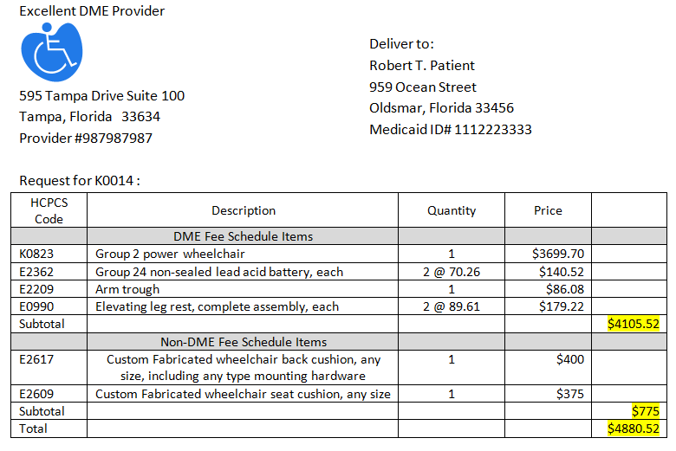
Invoice Requirements
Example of Invoice
Documentation
A list of each component and related fee described by HCPCS procedure codes on the current DME and Medical Supply Services Provider Fee Schedules
The invoice subtotal
A list of all components including items not listed on the DME and Medical Supply Services Provider Fee Schedules, its applicable HCPCS code, and the provider’s requested price for each individual component
The invoice total, excluding all shipping and handling fees

Slide 11
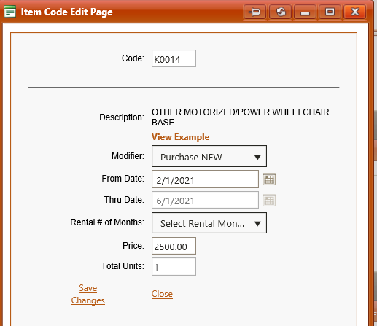
Wheelchair/POV HCPCS Codes
The following HCPCS Codes should be used for:
Custom Wheelchairs
      K0014-Custom Power wheelchair
      K0009-Custom Manual wheelchair
Note: When Any component is added to a wheelchair, it becomes a custom wheelchair.
Power Operated Vehicle (POV)
    K0800
    K0801
    K0802
Patient Lifts
    E0630
    E0635
Labor
    K0739
Items with no appropriate HCPCS Code or not on the Fee Schedule
    K0108
Reminder: Any additional DME Items should only be added on the invoice.

Slide 12
EPSDT
The Early and Periodic Screening, Diagnostic and Treatment Services program ensures that children and youth under age 21 receive a comprehensive array of preventive, diagnostic, and treatment services.
Requests for children under the age of 21 for items on the DME fee schedule over the limits are considered EPSDT or Special Services.
Requests for children under the age of 21 for items not on the DME fee schedule are considered EPSDT or Special Services.
Many Items that recipients under age 21 may not have the actual HCPCS code loaded in eQHealth or they are unable to be transmitted to the PA system at Florida Medicaid – in those instances please use the following codes
  A9900-Continence, Ostomy, and Wound Care supplies
  E1399- DME Items that exceed the limits or services not listed on the fee schedule

Slide 13
Question Rephrased in eQsuite®
Is this a DME supply that is covered under the EPSDT benefit for quantities over the limits on the DME Fee Schedule, or the item is not on the DME Fee Schedule?
We have provided some helpful tips on how to answer this question correctly to avoid any potential delays in the review process.
EPSDT: Early and Periodic Screening, Diagnostic and treatment ONLY applies to recipients under the age of 21. If you are submitting a case and the recipient is over 21 this question does NOT apply, and you should be checking “NO”
Example: If the recipient is under 21 and the item is NOT on the fee schedule or if the Item is over the fee schedule limit you should be checking –Check “Yes”
Example: Recipient is under 21 and you are requesting A9900 Continence, Ostomy, and Wound Care supplies- Check “Yes”
Example: Recipient is under 21 and you are requesting E0316 (SAFETY ENCLOSURE FRAME/CANOPY FOR USE WITH HOSPITAL BED, ANY TYPE)-This item is on the Fee Schedule. Check “No”

Slide 14
Special Services
A9900
A9900-Misc Continence, Ostomy and Wound Care
Required Supporting Documentation
RX signed within one year by appropriate practitioner (Physician, ARNP, Physician Assistant) within scope of their license
Sales invoice
Clinical Documentation completed within one year of the request. Must support the medical necessity that is described. (i.e., physician visit notes; any other relevant discipline visit notes)
Continence supplies for recipients
As initiated on August 29, 2023, through rulemaking and effective January 10, 2024, providers can bill for incontinence supplies provided to Medicaid recipients ages four (4) and above that are determined medically necessary in accordance with Agency policy, using the codes and rates as listed on the Durable Medical Equipment and Medical Supply Services Provider Fee Schedule.
Has chronic incontinence caused by a permanent physical or mental condition (including cerebral palsy and developmental delay).
Required ICD 10 Diagnoses by Label or code. An incontinence DX must be accompanied by a DX that supports the rationale for the incontinence.
Note:
If you have more than one Item that requires an authorization these codes must be entered into eQsuite® separately

Slide 15
Special Services
E1399
E1399- DME Items that exceed the limits or request services not listed on the fee schedule
Required Supporting Documentation
RX signed within one year by appropriate practitioner (Physician, ARNP, Physician Assistant) within scope of their license
Providers Sales invoice
If it’s a Manually Priced Item, include the Manufacturers Pricing.
Clinical Documentation completed within one year of the request. Must support the medical necessity that is described. (i.e., physician visit notes; any other relevant discipline visit notes)
Note:
If you have more than one Item that requires an authorization these codes must be entered into eQsuite® separately

Slide 16
Special Services
Pulse Oximetry
E0445-Oximeter Device for measuring blood oxygen levels, non invasive
Required Supporting Documentation
RX signed within one year, ICD 10 Diagnosis with Freq and Duration
Clinical Documentation completed within one year of the request. Must support the medical necessity that is described (I.e. physician visit notes; any other relevant discipline visit notes laboratory results; diagnostic test results; records of repeated metrics oxygen delivery rates, pulse ox readings, ventilator settings)
Note:
This is a rental Item only
This code does require prior authorization however it does not require a PA #. When you receive authorization, the letter will NOT generate a Prior Authorization number. To avoid a denial on your claims, make sure to include your authorization letter.

Slide 17
Special Services
Glucose Monitoring
A9276-Disposable sensor, CGM Sys
A9277-External Transmitter, CGM
A9278-External Receiver, CGM Sys
Required Supporting Documentation
RX signed within one year, ICD 10 Diagnosis with Freq and Duration
A current comprehensive glucose level log
Clinical Documentation completed within one year of the request. Must support the medical necessity that is described (I.e., physician visit notes; any other relevant discipline visit notes laboratory results; diagnostic test results; records of repeated metrics such as weights, blood sugars logs, Ac1 readings)
Note:
These codes may be entered all on one review

Slide 18
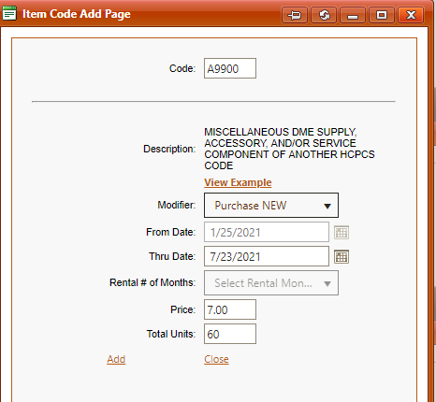
Entry for Special Services
Enter Your Code
Select the appropriate modifier
From/Thru Date is your authorization Date Span-You can request up to 180 Days
Enter the Price-Per Unit, not the total of all units
Example: Recipient needs 10 cases of wipes a month for 6 months at $7.00 a case. You will enter the price as $7.00
Total Units = Total Units for the Date Span entered
Reminder: If you have more than one request for a MISC DME supply, these requests must be entered into eQSuite® separately.
Enter HCPCS Code
Enter authorization date span
Enter price for 1 unit
Enter total units for entire date span

Slide 19
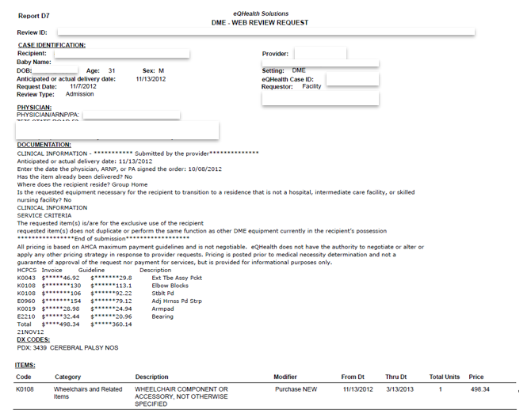
D7 Report
DME Web Review Request Print Out
Pricing determinations may be viewed in the D7 report in eQSuite®
Pricing is based on AHCA maximum payment guidelines and is not negotiable. eQHealth does not have the authority to negotiate, alter, or apply any other pricing strategy. Pricing information is available prior to a medical necessity determination. This information does not guarantee approval of the request nor payment for services.

Slide 20
Live Demonstration

Slide 21
eQHealth Resources
Phone: 855-444-3747
Fax: 855-440-3747
(General inquiries/questions)
Provider Website:
FL.ACENTRA.COM
(Provider Forms/Education and Training Material)
Provider Outreach Email:
PR@ACENTRA.COM
(Provider Education/Training Assistance)

